Slide 1
Daily Step Tracker With goal monitoring
YaShfa Arif (bcy243034)
Rahim ullah (Bcy243017)
PRESENTED TO: Syed Waqas ayub shah

Slide 2
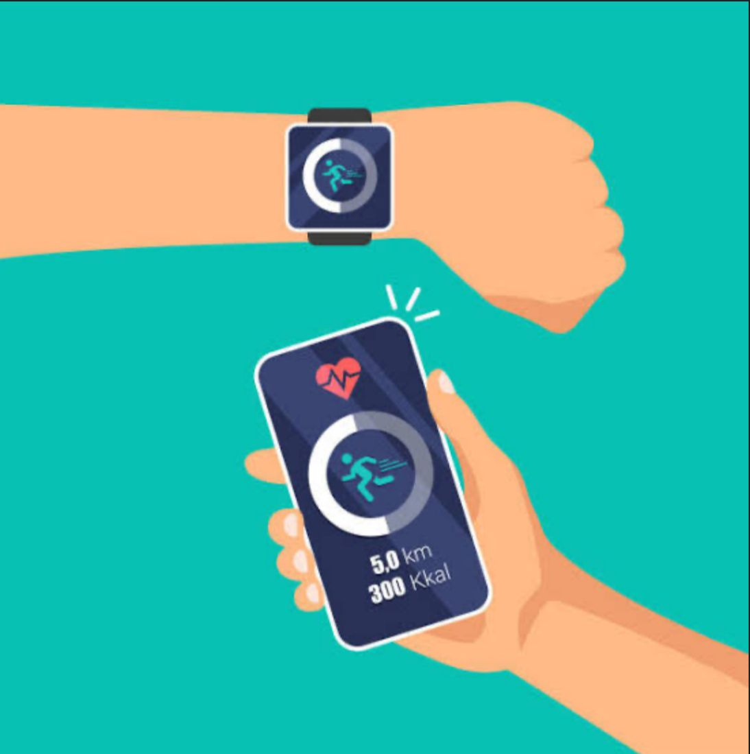
Introduction:
A tool to help users track their daily step goals.
Provides feedback based on performance.
OBJECTIVES:
Motivates users to stay active .
Encourages healthy habits.

Slide 3
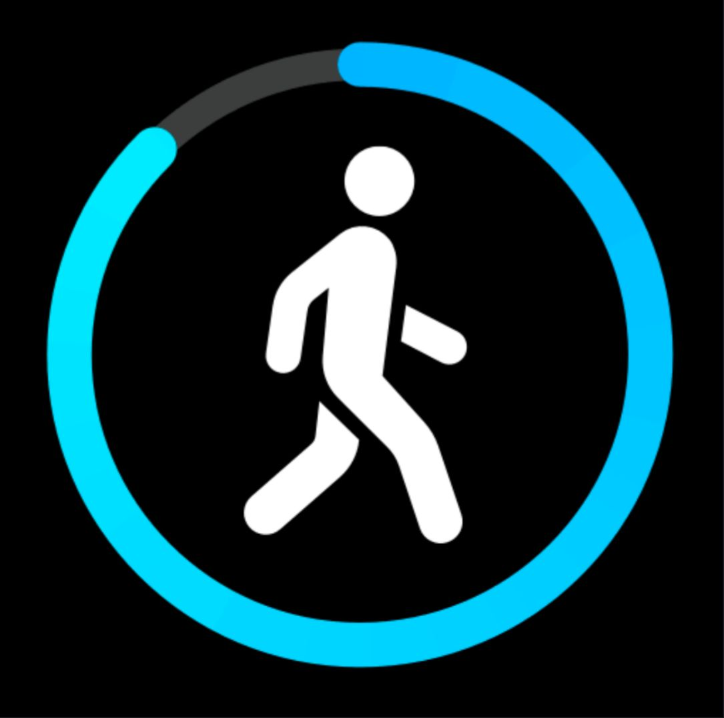
Program Features:
Ensures valid input for daily goals and steps.
Rejects negative or invalid inputs.
It gives feedback if the goal was met,
missed or exceed.
It provides user friendly interface
that is simple.

Slide 4
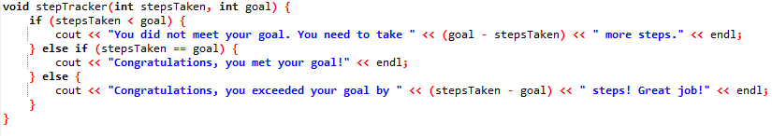
Use of function
In function we have said that if step taken is less then goal, message will pass out that the goal was not met.
Else message will pass out the goal was met!
Code Snippet:

Slide 5
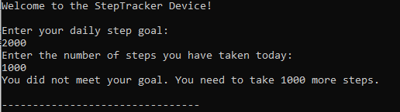
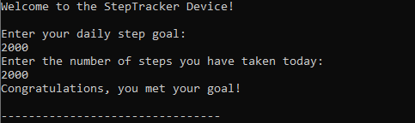
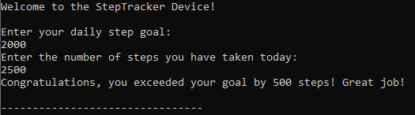
Output sample:
GOAL NOT MET:
GOAL MET:
GOAL EXCEEDED:

Slide 6
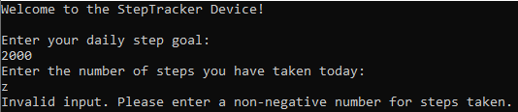
Invalid input:

Slide 7
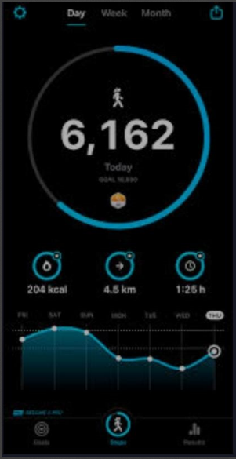
conclusion:
Encourages an active lifestyle.
Provides helpful feedback to users.
Demonstrates how simple programs can
be impactful.

Slide 8
THANK
YOU!

